Slide 1
BANKING MANAGEMENT SYSTEM
Made By:-
Name:- Parash chand / Venkateshwar Reddy

Slide 2
Introduction of Banking Management System
The Domain “Banking Management System “keeps the day by day tally record as a complete banking. It can keep the information of Account type, Customer, Deposit, Transfer, Withdrawal, and Searching the transaction, Transaction report, Individual account. The exciting part of this project is not display it of user, access of Account type. transaction reports are show in the system”.

Slide 3
Existing System
In the existing system the transactions are done only manually. The complexity of this system is increase while no of customer and with there no of transaction will be perform.
Problem with Existing System:-
Lack of security of bank information.
Require more physical work and man power.
Time consuming for manual entry and editing data.
Consumes large volume of pare work.
Damage of machines bank information loss and no backup of information.

Slide 4
Proposed system
The aim of proposed system is to develop a system of improved facilities. The proposed system can overcome all the limitations of the existing system. The system provides proper security and reduces the manual work. It provides flexibility to the user to transfer the data through system very easily by compressing the amount of file.
Advantages of the proposed system:-
Information will be Secure of data.
Required less paper work and man power.
Minimize manual data entry and record keeping.
Minimum time needed for the various processing.
Better service for maintaining of data.
Minimum time required and avoid calculation error.

Slide 5
Scope of the System
The banks in today’s business environment. This exponential growth of Banks is attributed mainly to their much better local reach, personal interaction with customers, and their ability to catch the nerve of the local .
Initial information the followings are some of the objective of the study –
To study the Information Technology in view of research study.
To study the use of Information technological means in the system.
To study the feedback of the past transaction system.

Slide 6
Goals and Objectives
Main Goals.
Customer Satisfaction.
Saving Customer Time.
Protecting the Customer .
Transferring Money.

Slide 7
1. Main Goals:-
Our main motto is to develop a software program for managing the entire bank process related to Admin manage accounts of customer and to keep each every track about their property and their various transaction processes efficiently.
2. Customer Satisfaction:-
Client can do his operations comfortably without any risk or losing of his privacy. Our software will perform and full fill all the tasks that any customer would desire.

Slide 8
3. Saving Customer Time:-
Customer doesn't need to go to the bank to do small operation.
4. Protecting the Customer :-
It helps the customer to be satisfied and comfortable in his choices, this protection contains customer’s account, money and his privacy.
5. Transferring Money:-
It help customer transferring money to one bank to another bank.

Slide 9
Features
User registration for online banking if not register.
Transferring amount to the local customer account number.
Customer gets to know his last login date and time each time he logs in.
Customer can check all transactions made with their account.
Customer can check their account statement within a date range or after.

Slide 10
Aim
The aim of this “Banking Management System” This design to be expandable and modifiable and so a modular approach is used in developing the application software. In the existing system the transactions are done only manually but in proposed system we have to computerize all the banking transaction using the software Banking System.
The major operations in the system are:
Add Customer.
Deposit.
Withdrawal.
Account type.
Searching Transaction/ Transaction report.

Slide 11
Modules Description
1. User.
2. Add Customer.
3. Bank Accounts.
4. Transactions.
5. Check Book.

Slide 12
1. User:
User can access this project there is an authorization process. If you login an Admin then you will be redirected to the Admin Home Page.This performs the following functions: Create Add customer, Manage existing accounts.
2. Add Customer:
A customer who having the account in the world can create a virtual account through this module. This module receives the customer profile details and the bank account details.

Slide 13
3. Bank Accounts:
A customer may have more than one bank account in various banks, in this case, the customer prompted to decide which bank account should reflect in the account debit or amount credit.
4. Transactions:
This module displays the transactions made by the customer in the particular date with the transaction details.
5. Check Book:
It is useful because we can easily give a large amount to anyone in the form of cheque.

Slide 14
Hardware Requirements Specification
Various interfaces for the product details could be:-
Processor : Intel Pentium III or later.
Main Memory (RAM) : 1GB and Above.
Cache Memory : 512 KB.
Processor Speed : 1GHZ TO 2GHZ.
Mouse : Optical Mouse.
Hard Disk : 100GB and Above.

Slide 15
Software Requirements Specification
Front End/Language: VB.NET.
Back End/Database: MS Access.
Operating System: Windows 7, 8, 9, 10, XP (32bit and 64bit).

Slide 16
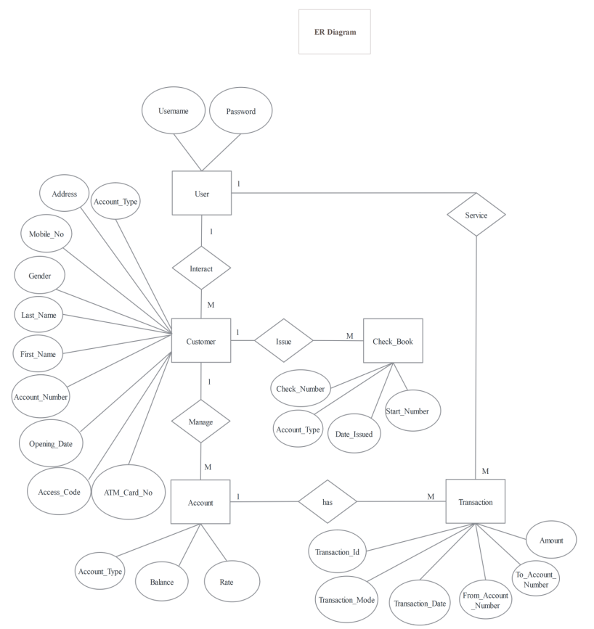
ER Diagram

Slide 17
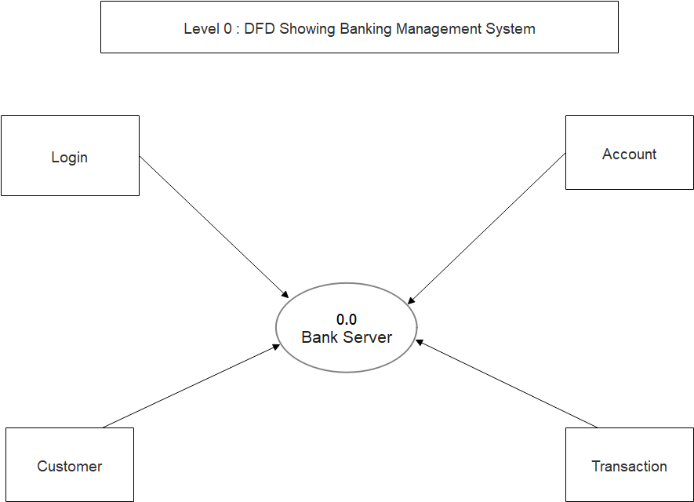

Slide 18
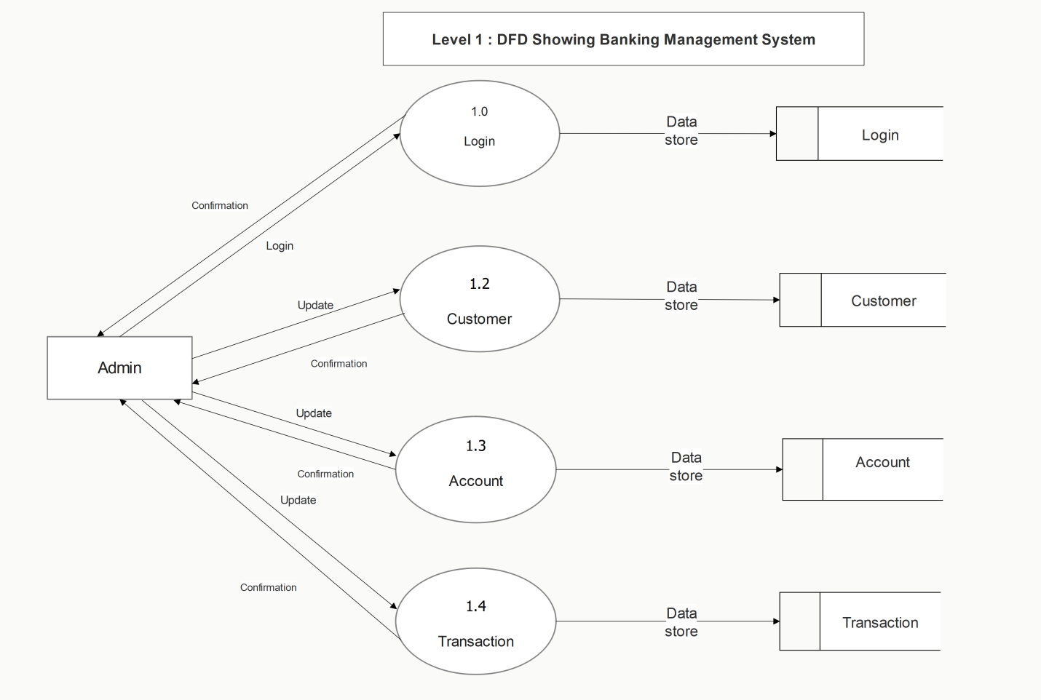

Slide 20
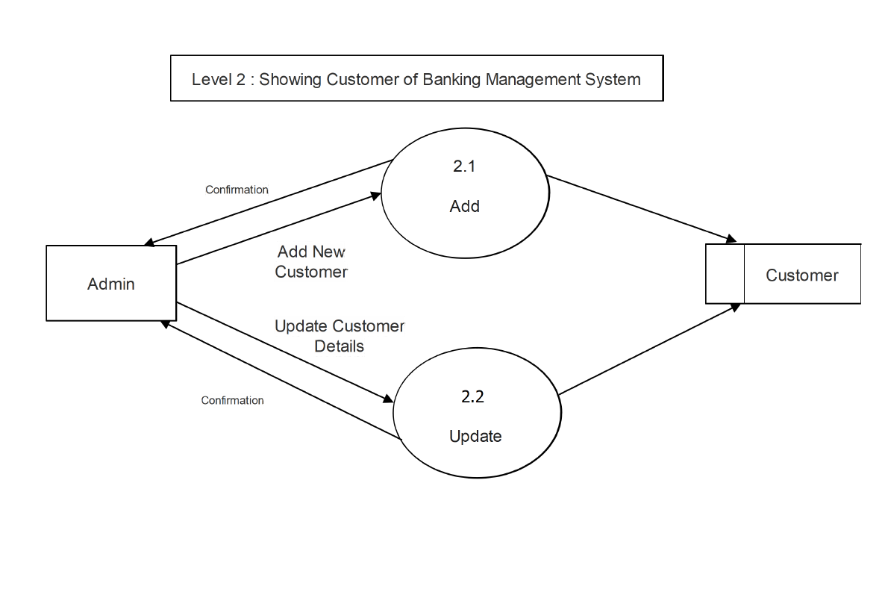

Slide 21
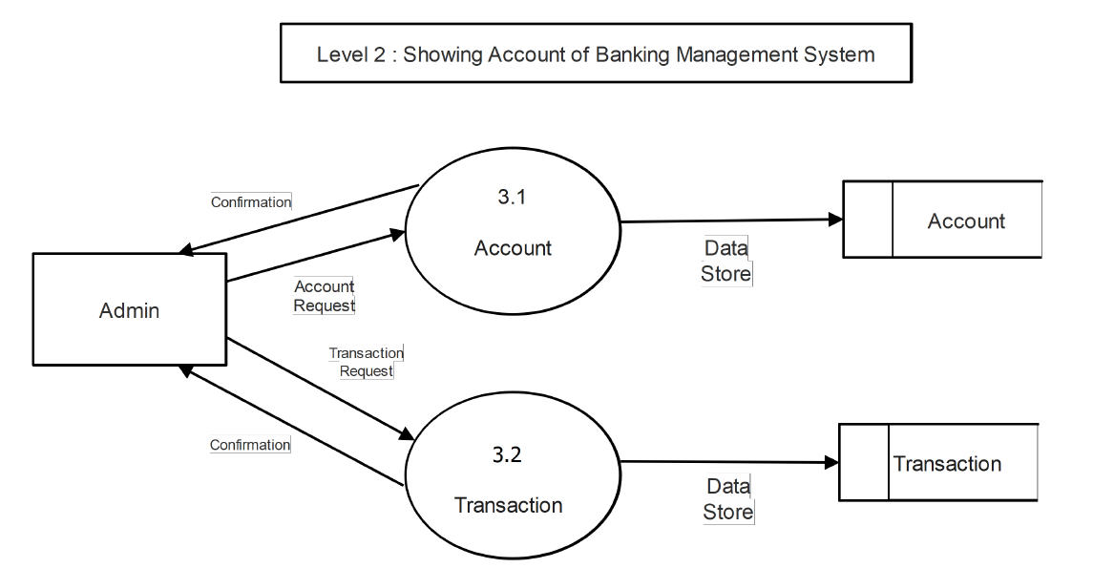

Slide 22
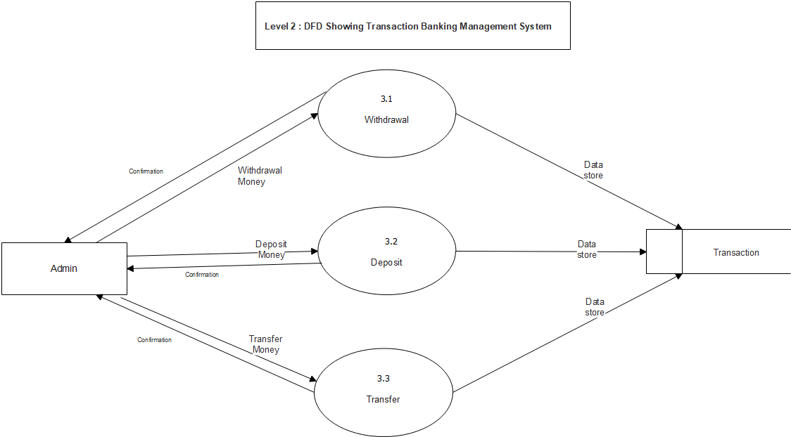

Slide 23
UML Diagrams

Slide 24
Sequence Diagram

Slide 25
Class Diagram

Slide 26
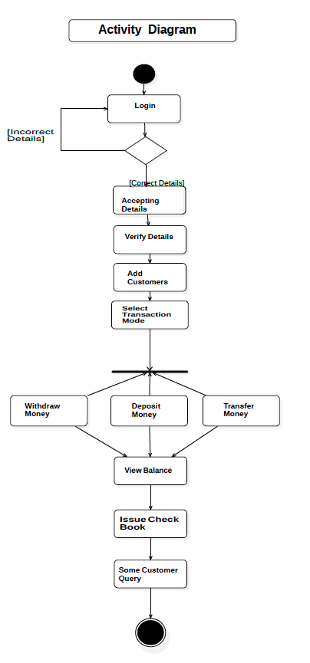

Slide 30
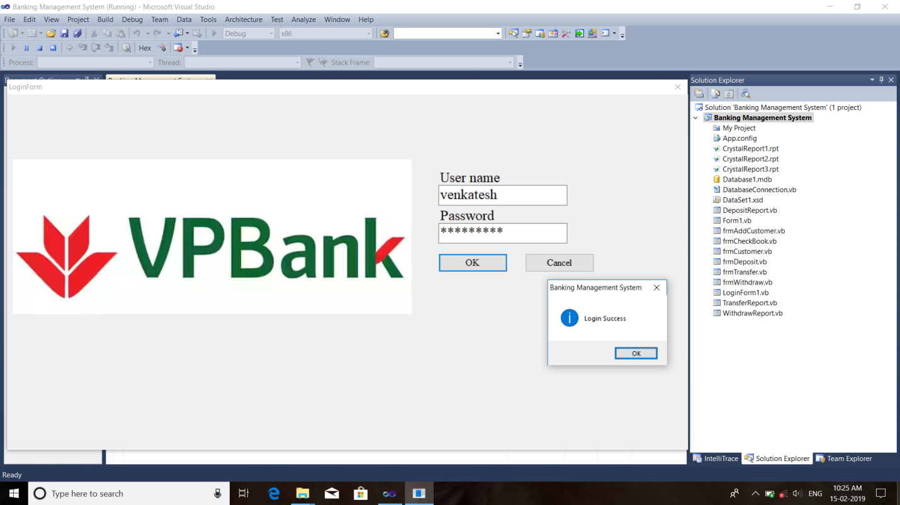
Login Screen

Slide 31
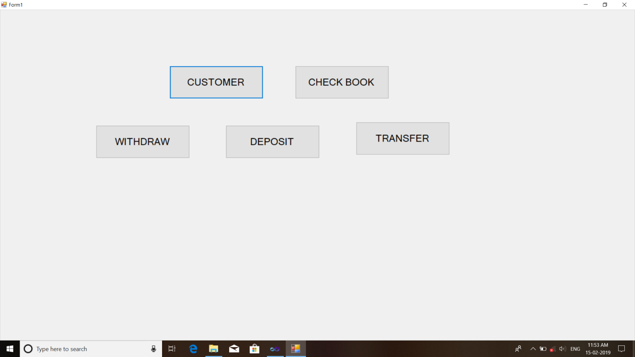
Main Screen

Slide 32
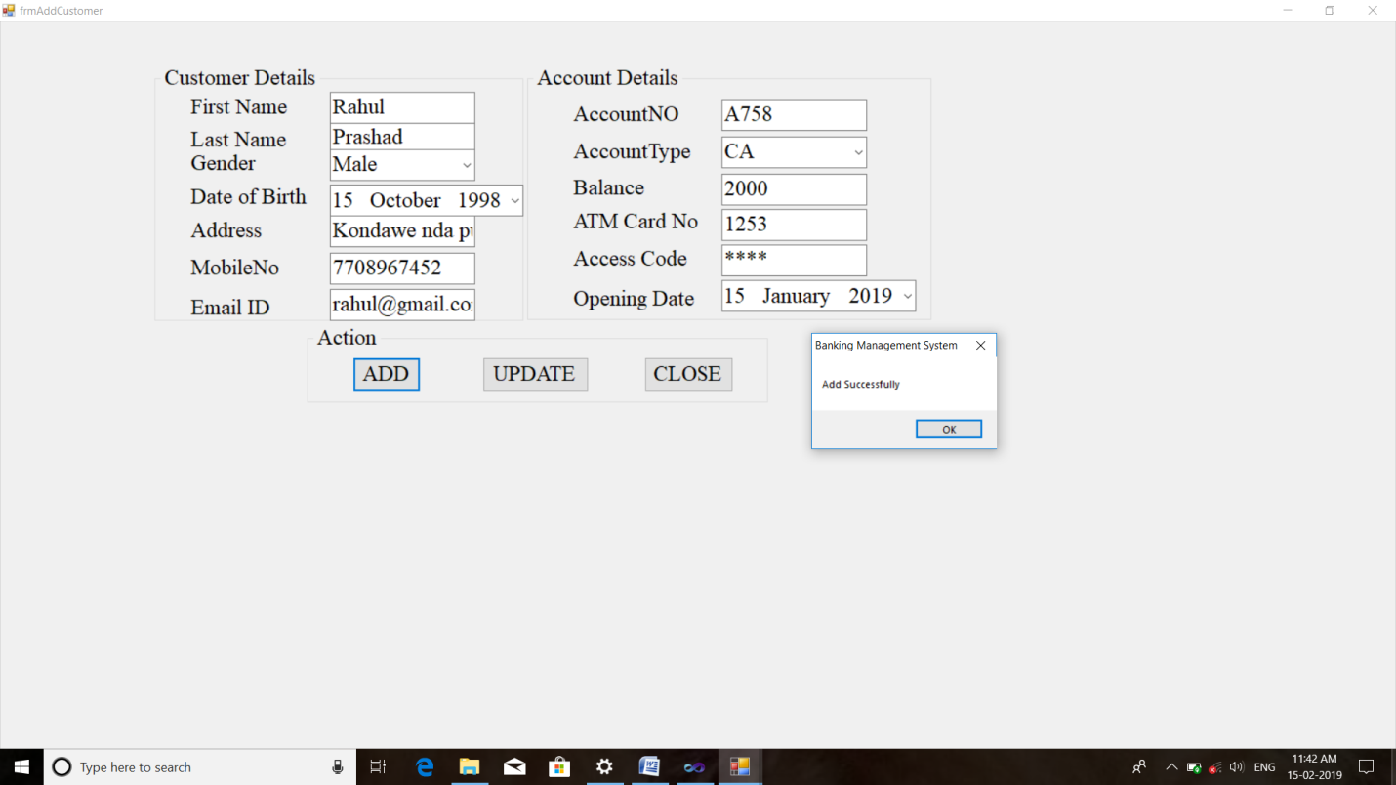
Add Customer Screen

Slide 33
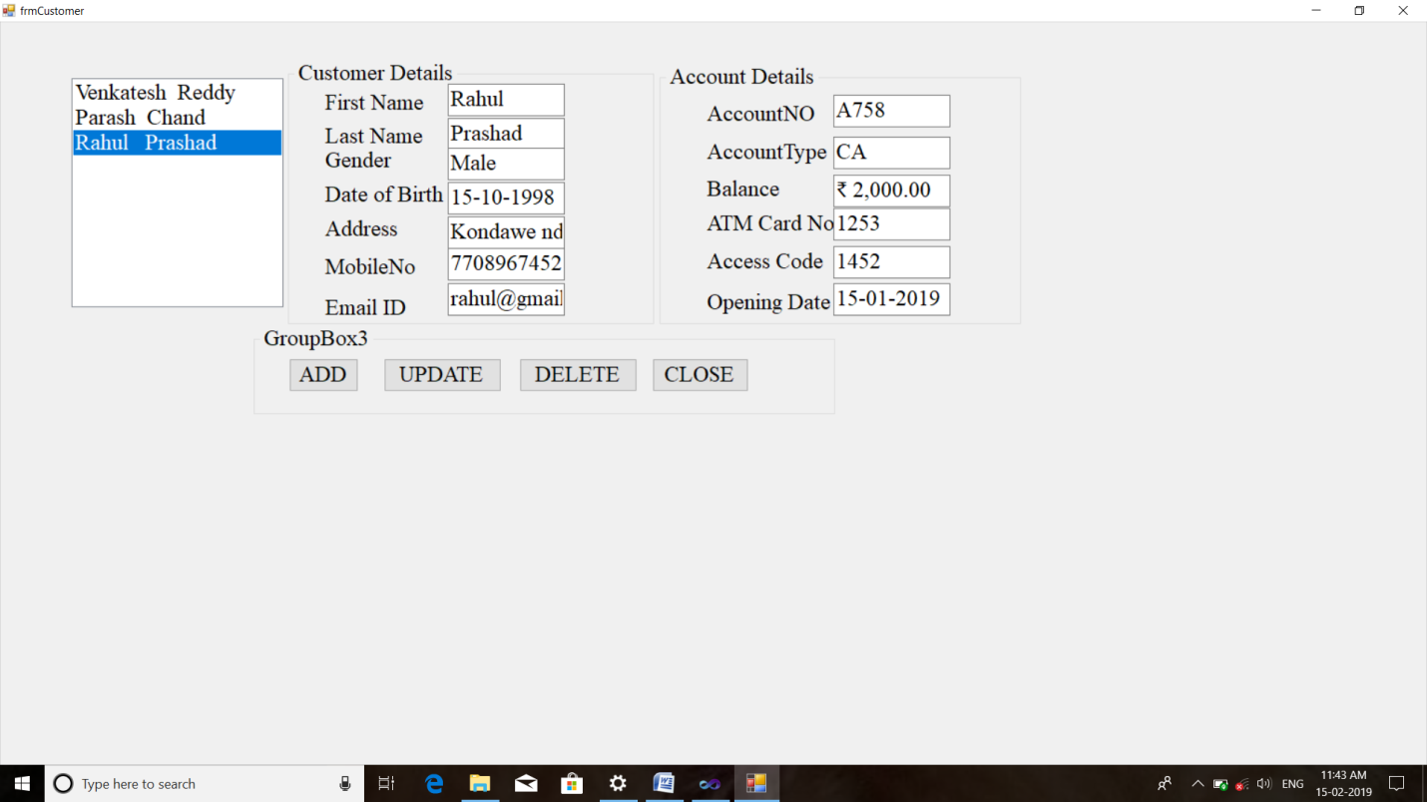

Slide 34

Update

Slide 35
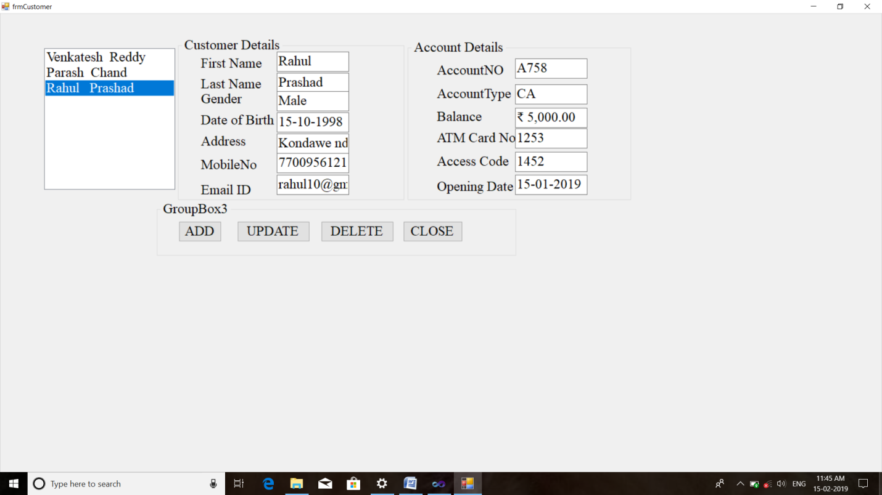

Slide 36
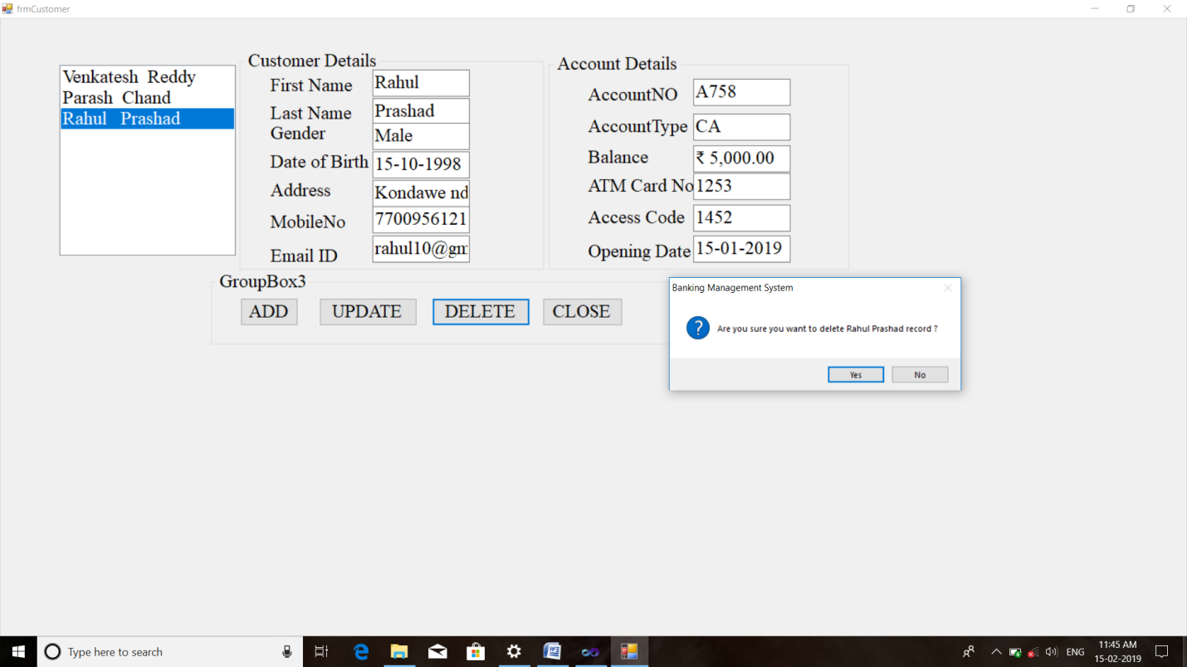
Delete

Slide 37
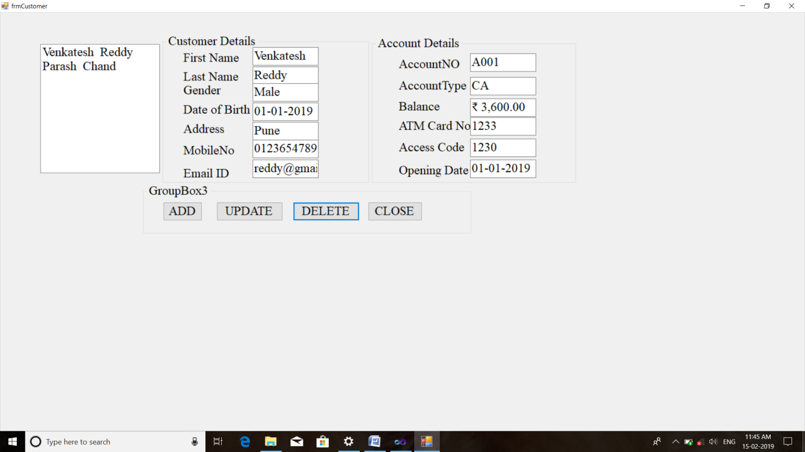

Slide 38
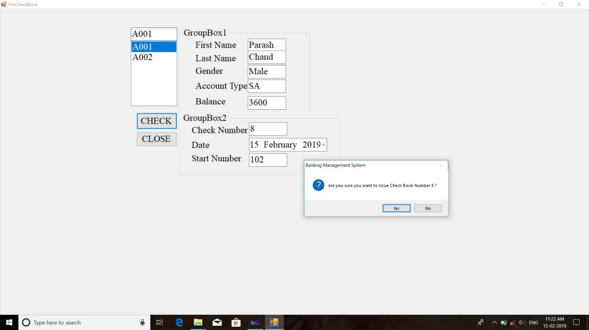
Check Book

Slide 39
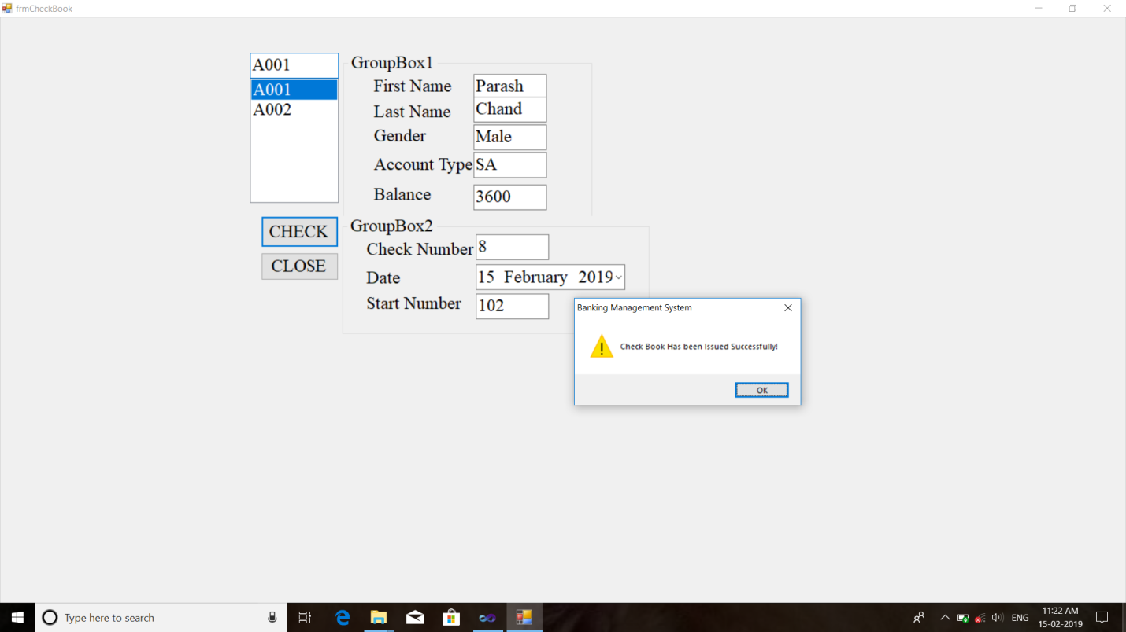

Slide 40
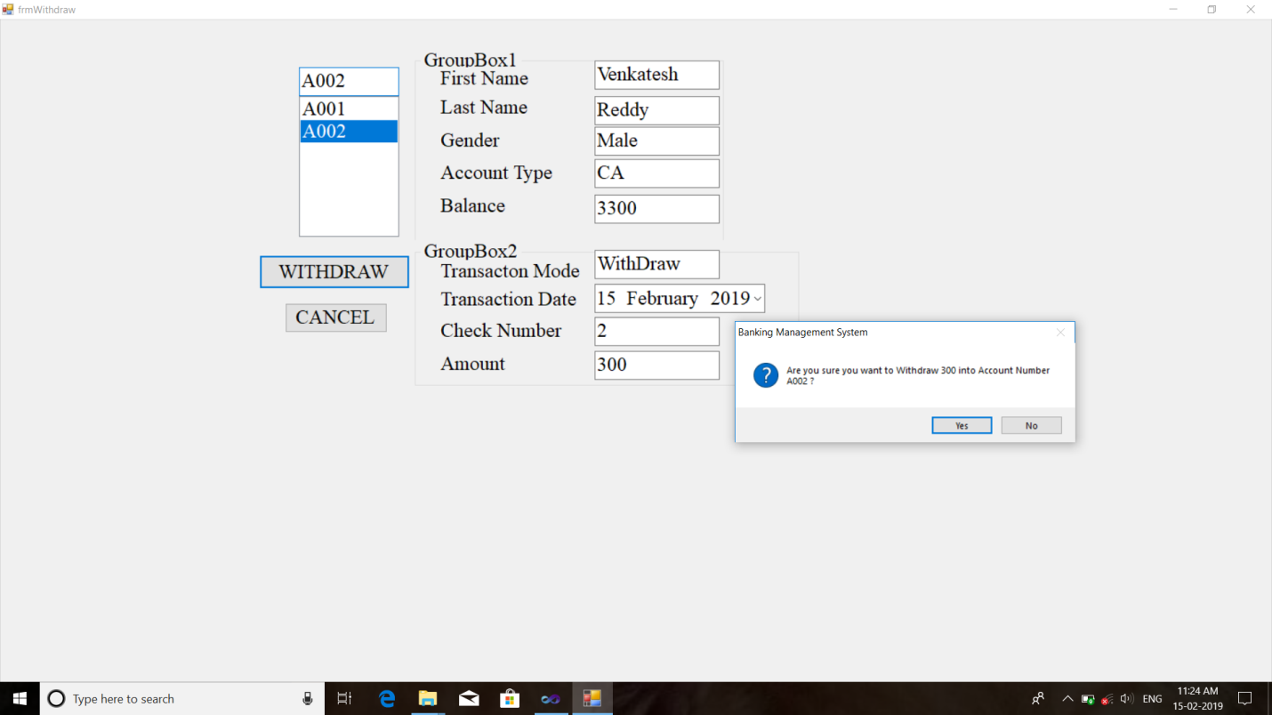
Withdraw

Slide 41
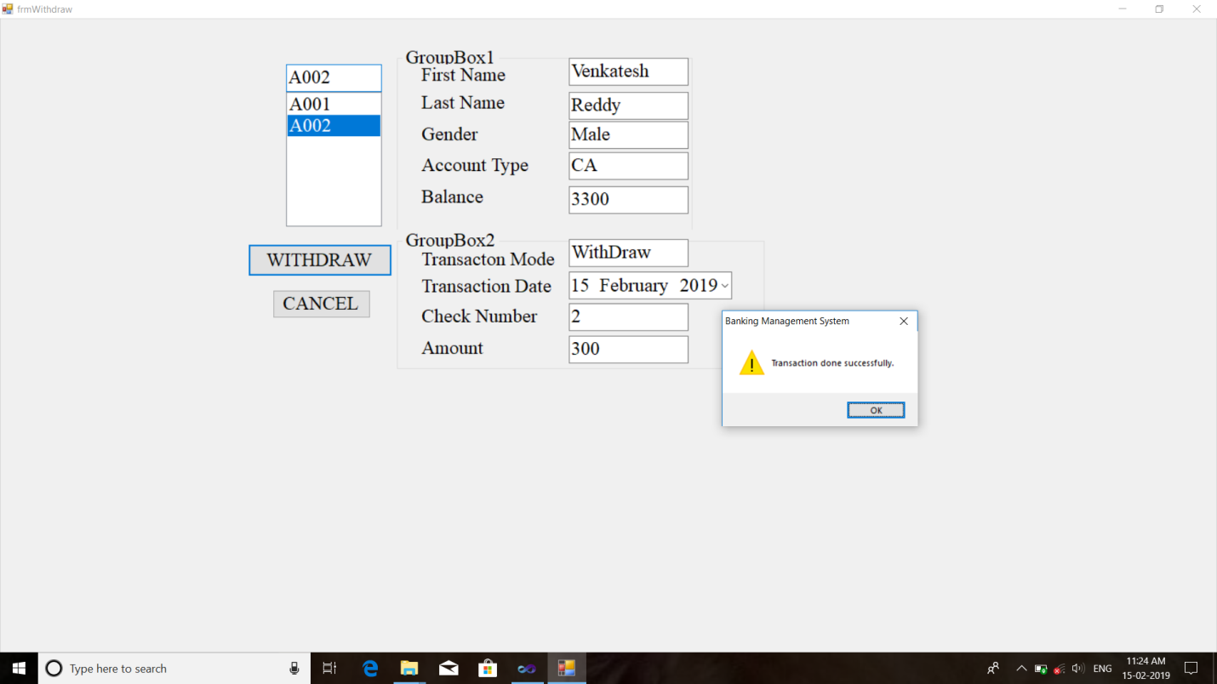

Slide 42
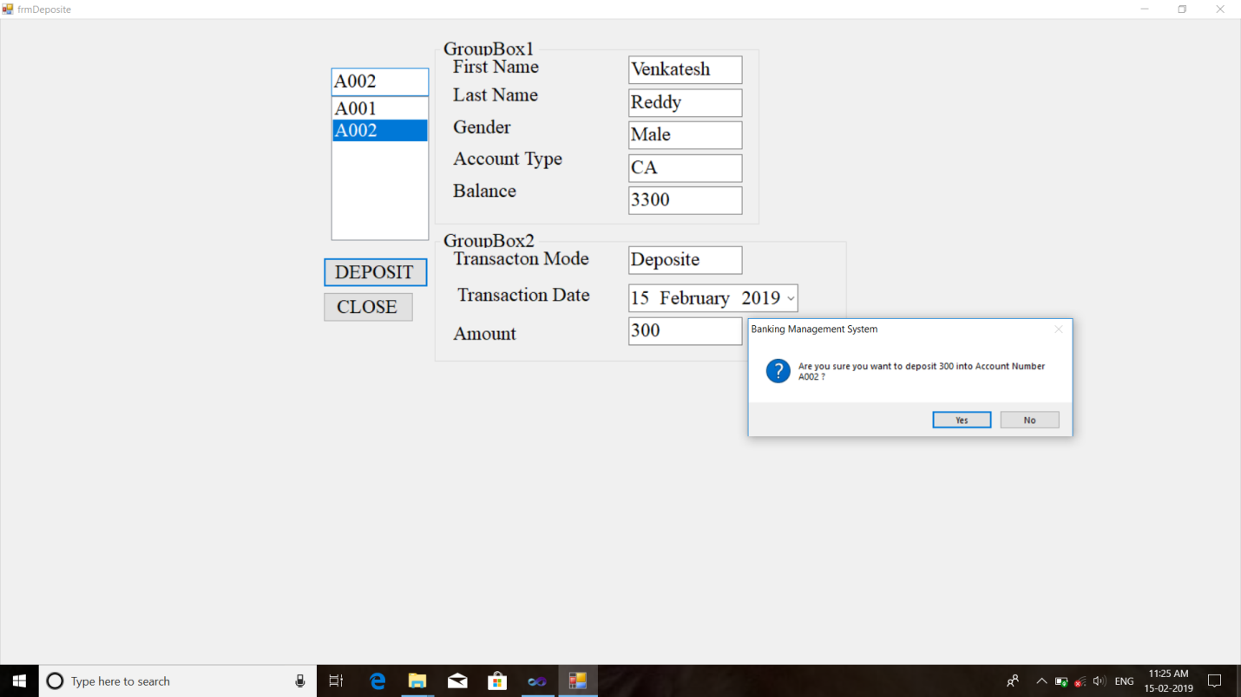
Deposit

Slide 43
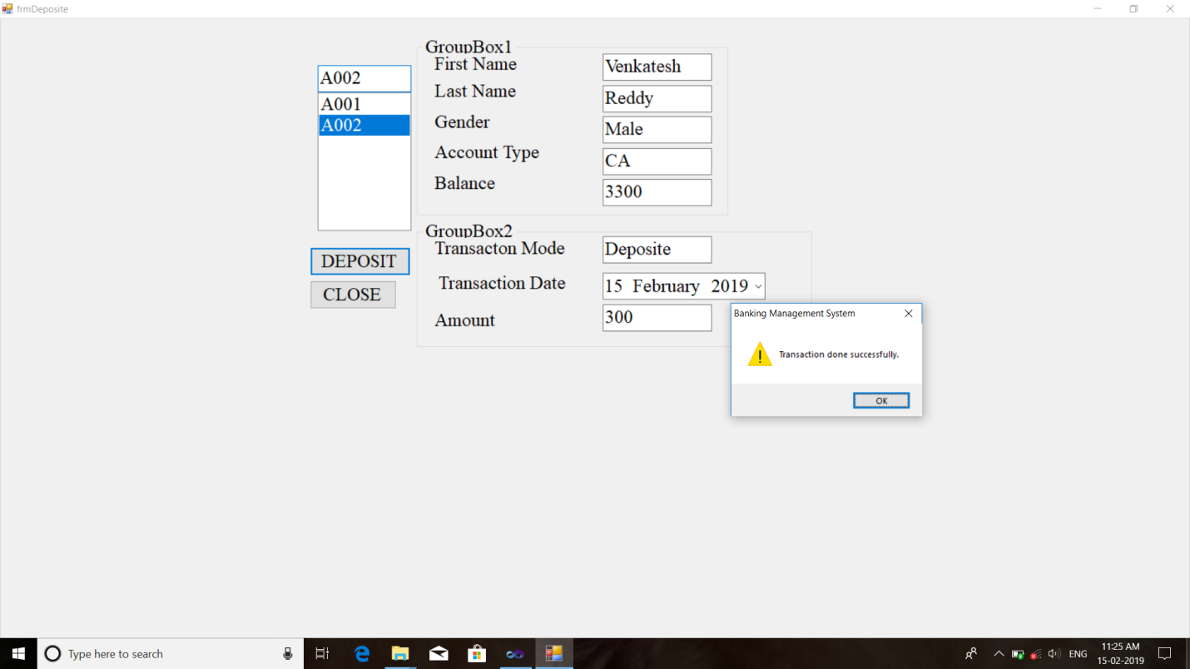

Slide 44

Transfer

Slide 45


Slide 46
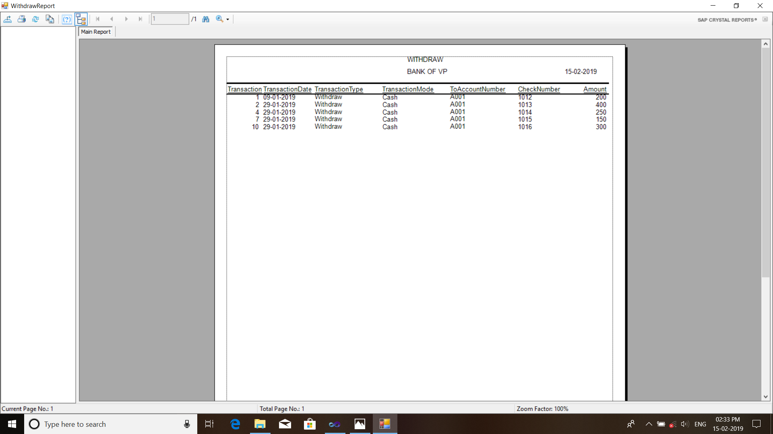
Withdraw Report

Slide 47

Deposit Report

Slide 48

Transfer Report

Slide 49
Future Enhancement
The “banking management system” is a big and ambitious project. To know what the future of online banking when you think of online banking, you probably think about a computer (either a desktop or laptop), a three or four step security process and then an interface that lets you view the balance of your various bank accounts and credit cards, whilst permitting you to transfer money, deposit money.
The most valuable future looks are following below:
More branches of the bank, maybe it will be international, that means more ATM machines outside.
Customer issues development based on their needs, so the help desk will be aware of their needs and easy to use.
Developing a mobile app for banking system that help users to do the obtained his operations without go to the bank only he need to sign in using his A/C No. And password and then use your own pin. Finally the system will update automatically.

Slide 50
Bibliography
Online reference:
Website: http://www.uml-diagrams.org
www.scribd.com
www.visual.com
Research Gate (Md. Jasim Uddin) www.researchgate.net/publication/31293322_Bank _Account_Management_System
VB.NET by Steven Holzner reference Black Book.

Slide 51
THE END

